Slide 1
Transfer Learning

Slide 2
Typologies
Finetuning
  start with a pretrained model and update all of the model’s parameters for the new task, in essence retraining the whole model.
Feature extraction
  start with a pretrained model and only update the final layer weights from which we derive predictions.
  it is called feature extraction because we use the pretrained CNN as a fixed feature-extractor, and only change the output layer.

Slide 3
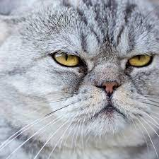

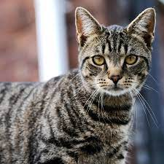
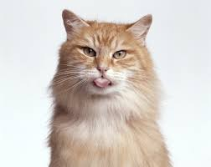
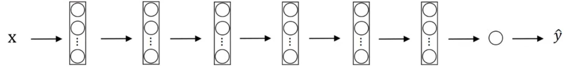
Example
others
Nives
Tigger
Softmax
1000 labels
Nives
Tigger
others
Freeze weights!
softmax

Slide 4
Embedding of x
Precompute final layer for each training example (embedding)
and save it to disk, then back prop only the soft-max
Freeze few layers if more labeled data

Slide 5
Data Augmentation

Slide 6
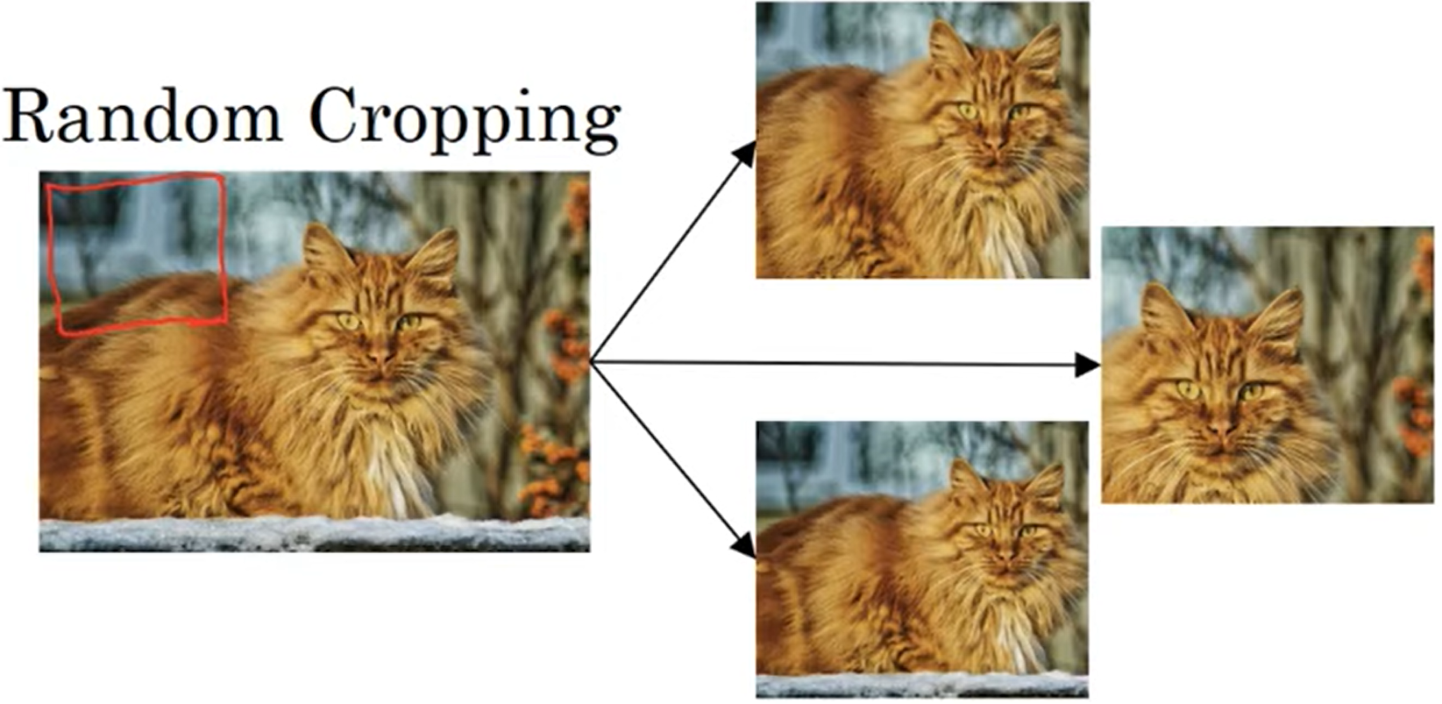
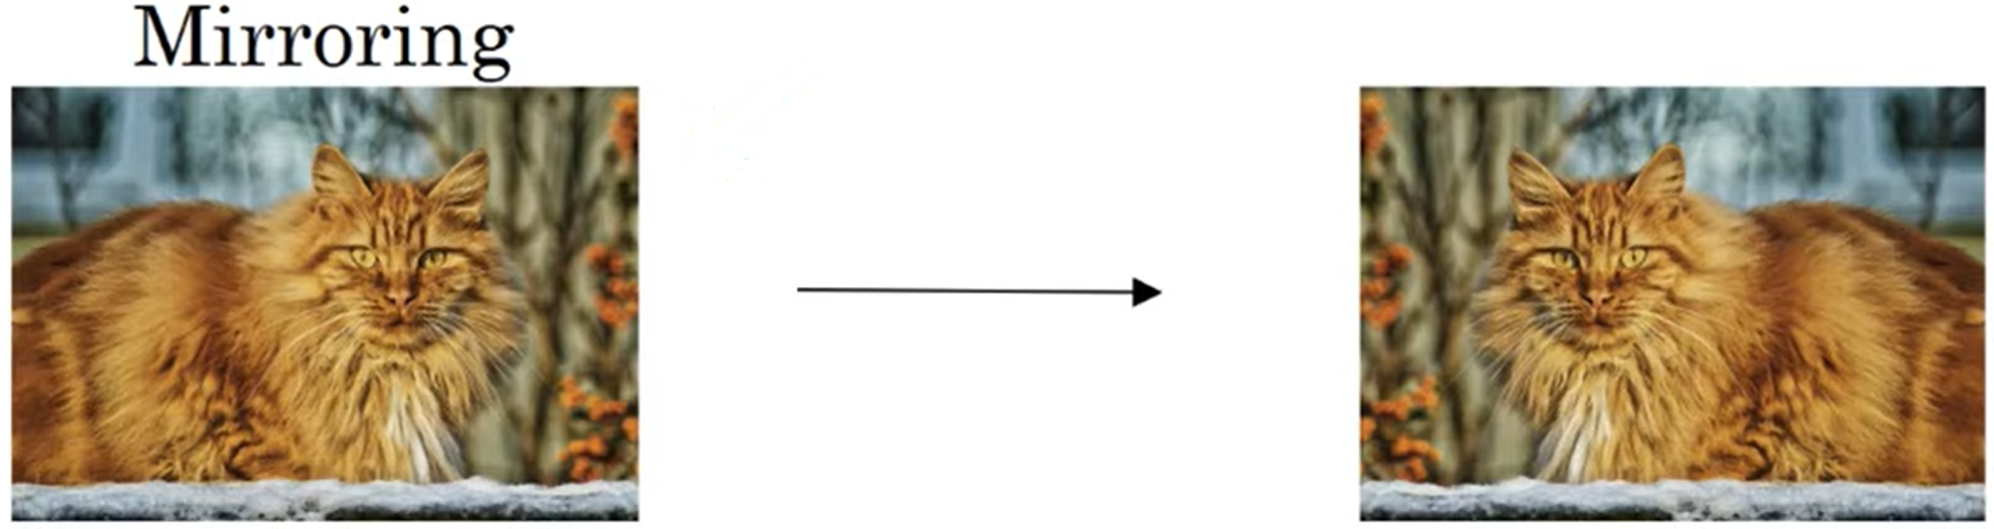
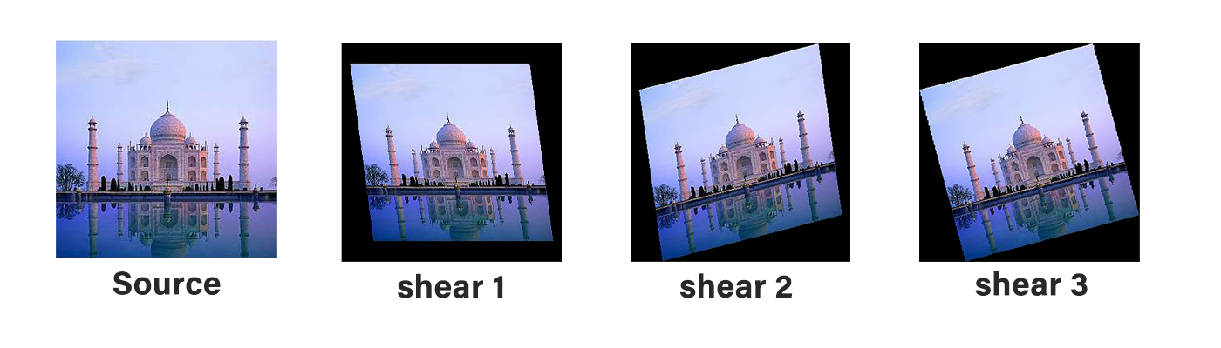
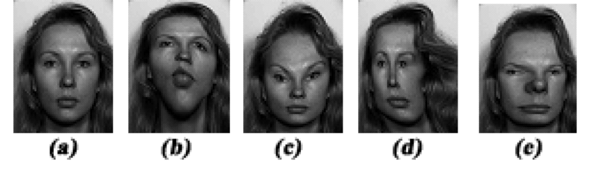
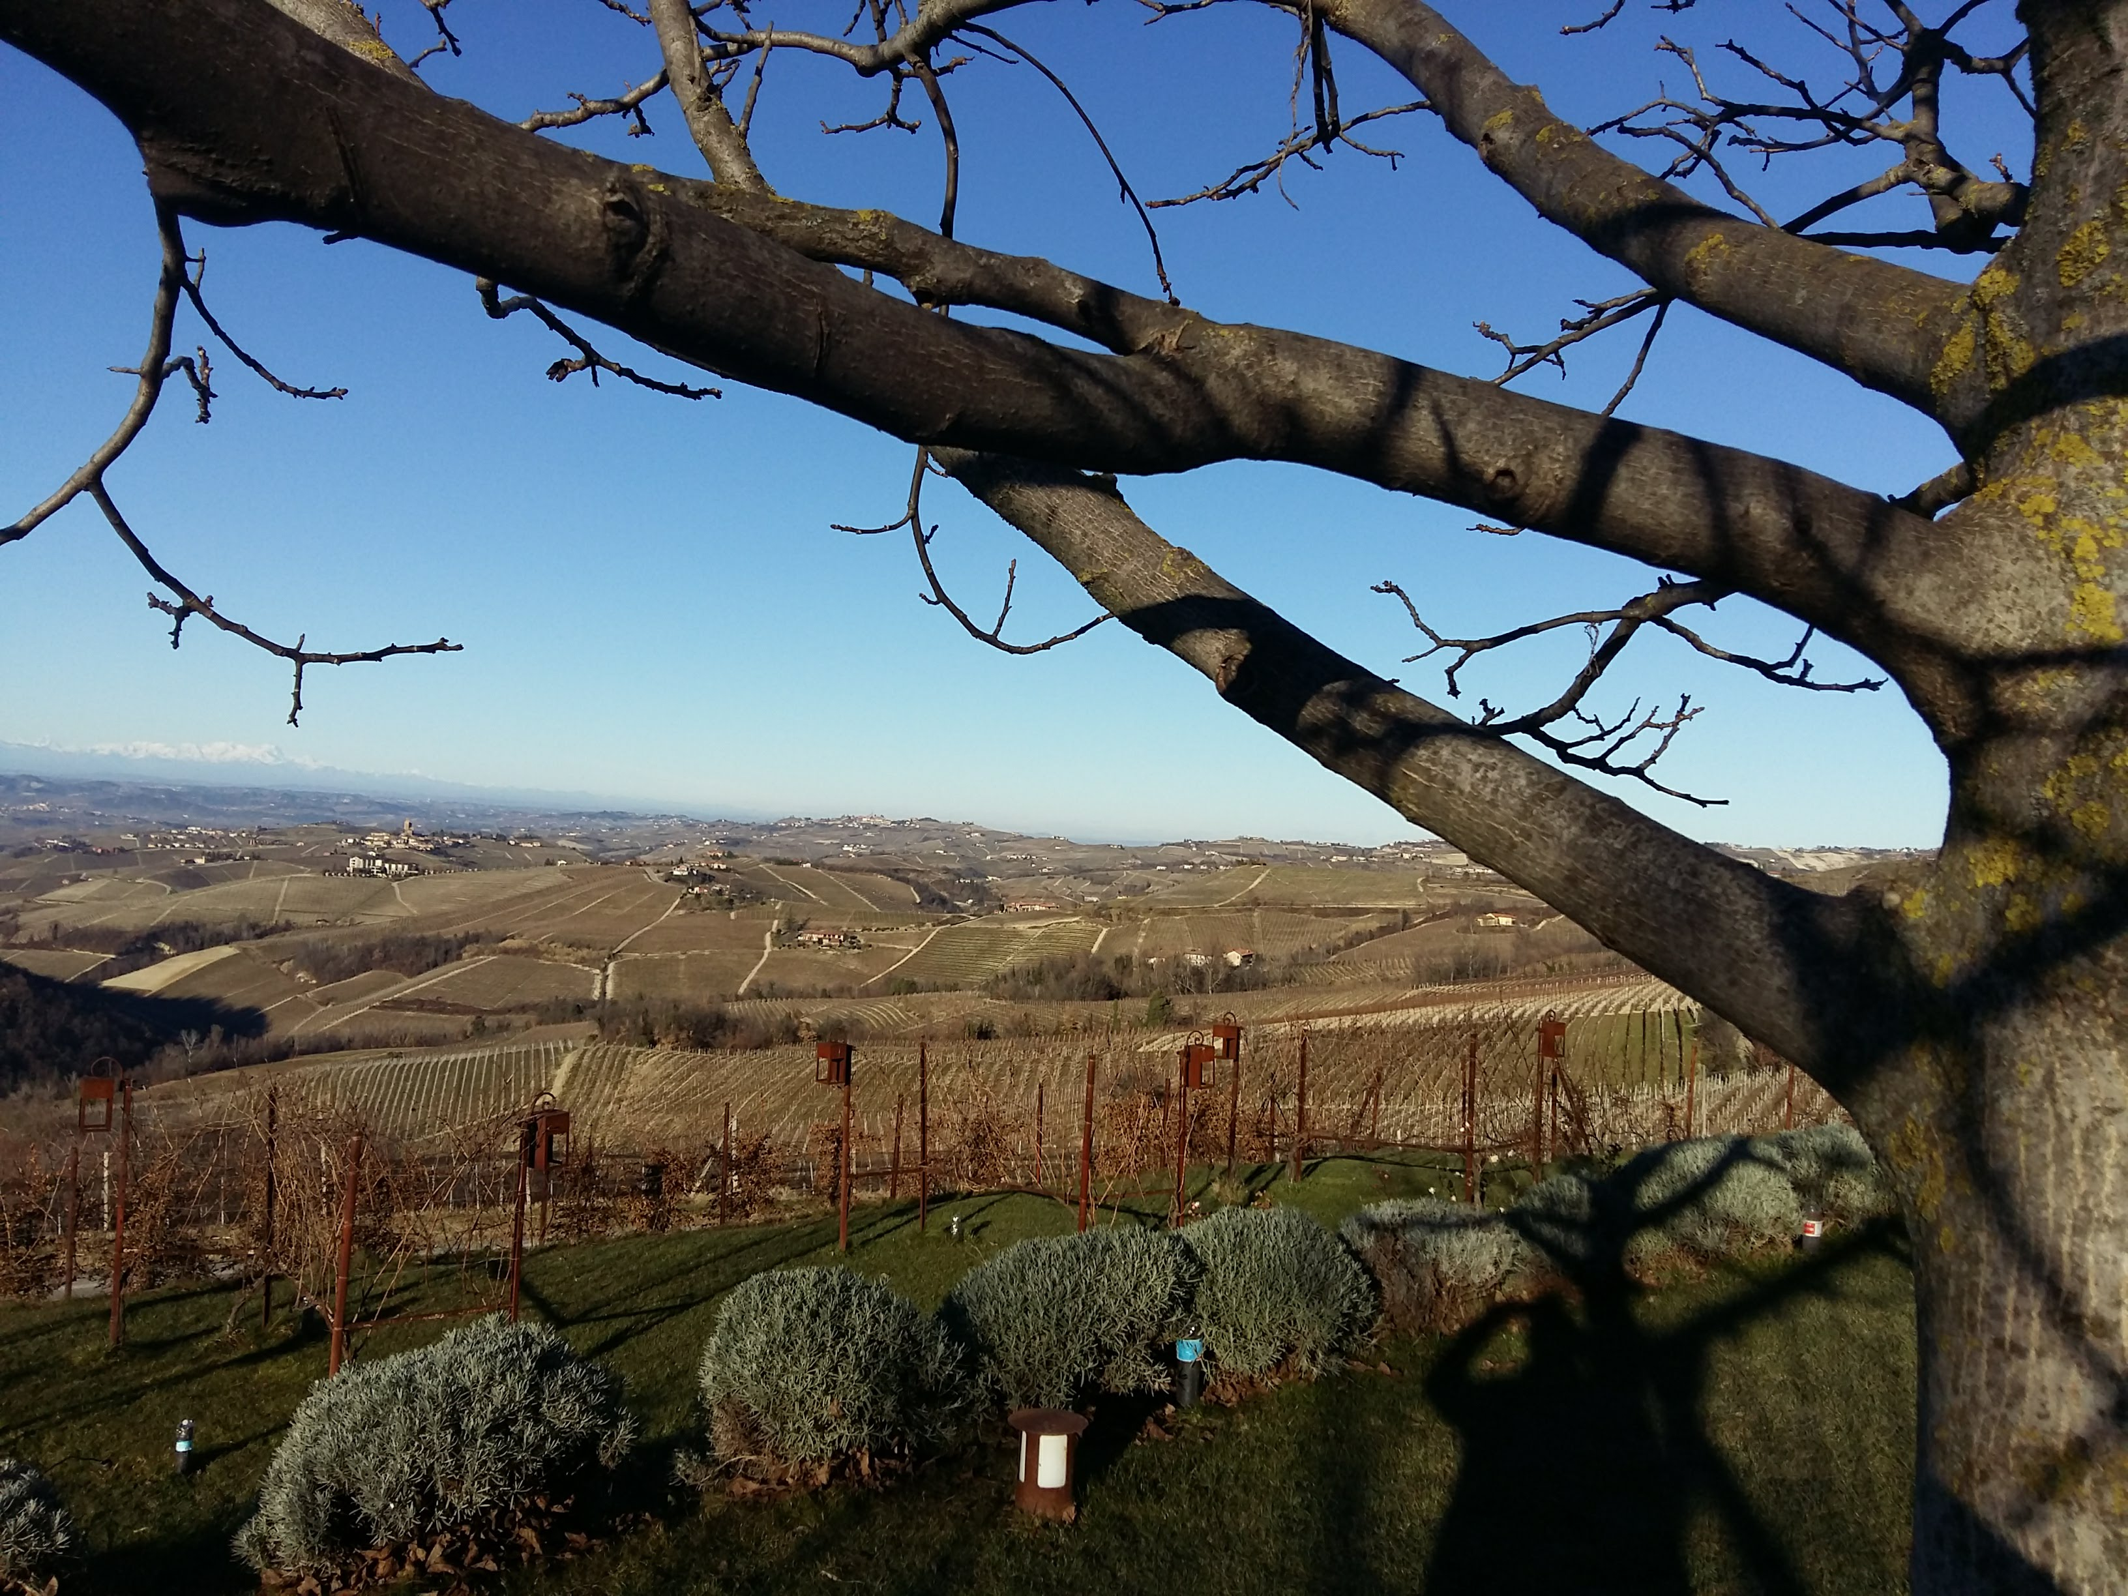
Shearing (taglio)
(local) Warping
Rotation

Slide 7
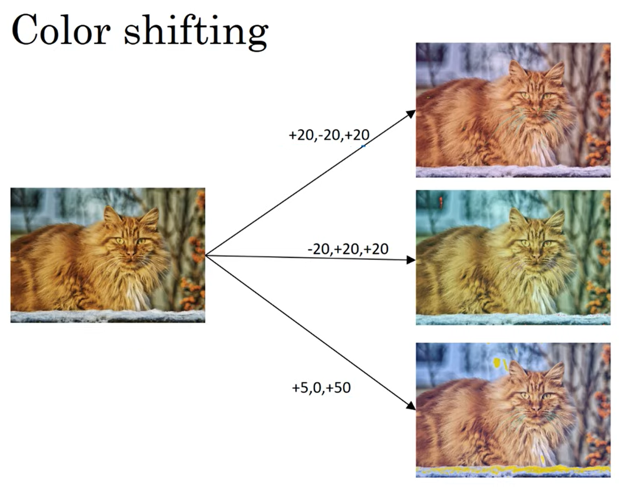
R G B

Slide 8
Data availability vs tasks
Less data
sophisticated algorithms
Lots of data
simpler algorithms
Object
detection
Image
recognition
Speech
recognition
Knowledge sources
  Labeled data
  Hand-crafted features / network architectures / other
  Transfer learning
  Data augmentation

